Slide 1




Mini
Project
Traffic Forecasting
Project
Feras Alsayigh , Abdullah Aloufi, Noura Aldawsari, Shahad Alhmoud
26 Aug, 2024

Slide 2
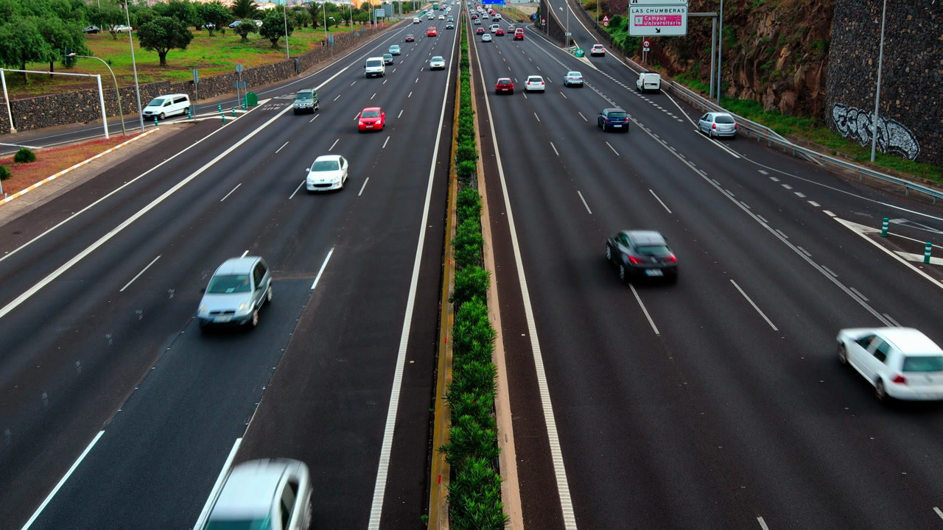
Introduction
Traffic forecasting is very important for city planning and management. Accurate predictions can help plan routes and allow emergency services to respond faster. With more and more vehicles on the road, managing traffic effectively has become more crucial than ever.

Slide 3


Agenda Overview
01
Objectives
04
Model Building
02
Data Collection
05
Model Evaluation
03
Traffic Data Analysis
06
Conclusion

Slide 4
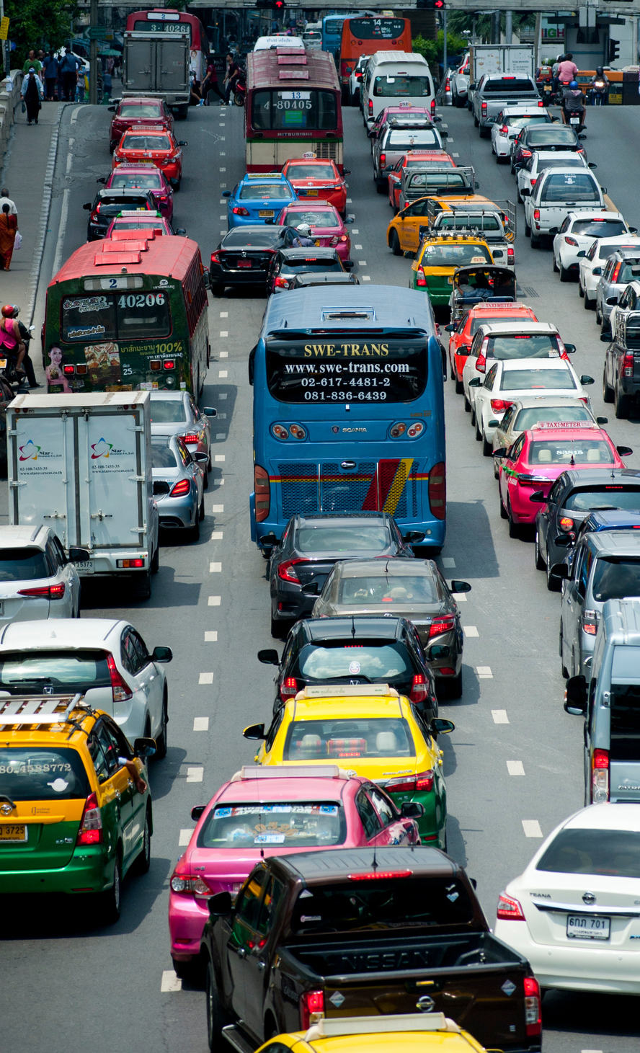


Objectives
The main goal of this project is to create a precise traffic forecasting model capable of predicting the severity of traffic accidents in real-time. By utilizing advanced deep learning techniques such as RNN, LSTM, and GRU, we aim to deliver actionable insights that can help reduce traffic accidents and by that prevent traffic jams.

Slide 5






Data Collection
Upload the data
The accident data were collected from February 2016 to March 2023, using multiple APIs that provide streaming traffic incident (or event) data.
We decided to collect our data open source from Kaggle.
Exploratory Data Analysis
Understanding the accident data for further processing.
Selecting Relevant Features
Taking the Feature that serves our goal is crucial step for accurate forecasting results.

Slide 6
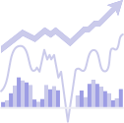
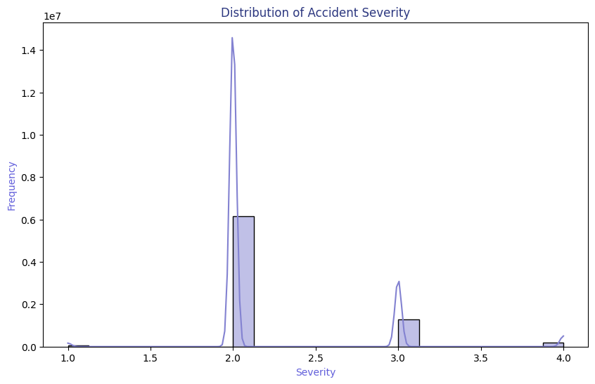

Traffic Data Analysis
We decided to
Take the most significant features that servers our goal.
Severity = 2

Slide 7



Work Flow
Model Development and Training
EDA
1
2
3
4
5
Data Gathering
Pre-processing
Model Evaluation

Slide 8

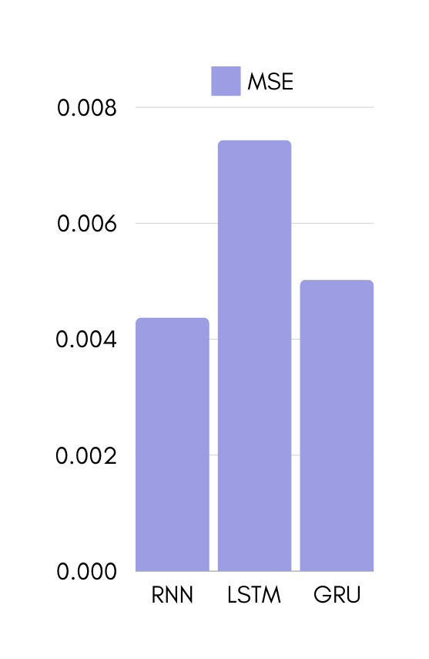
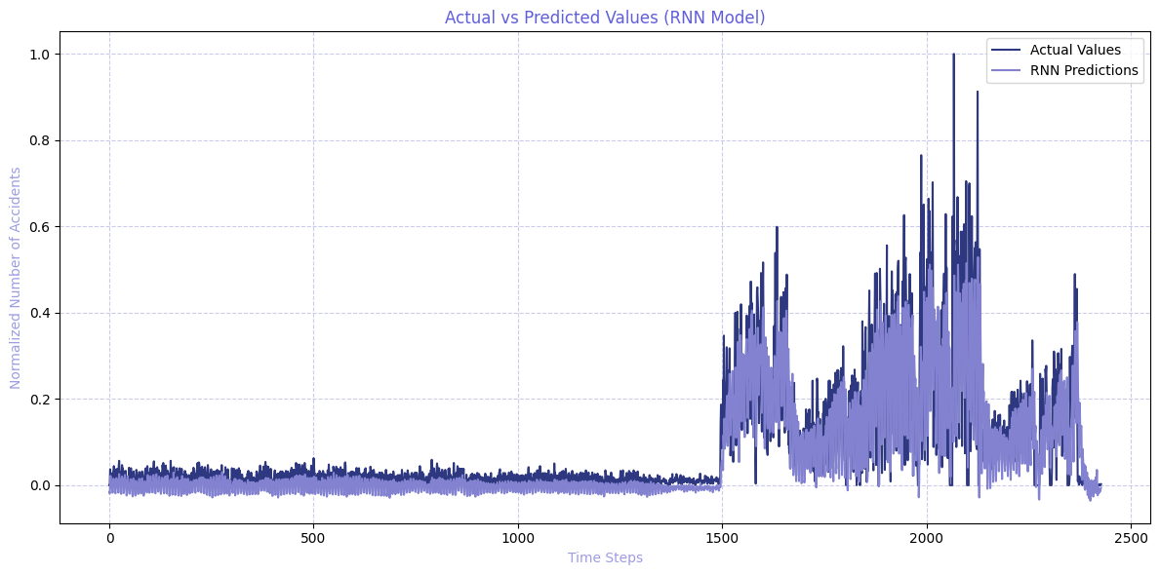
Model Evaluation (MSE)

Slide 9
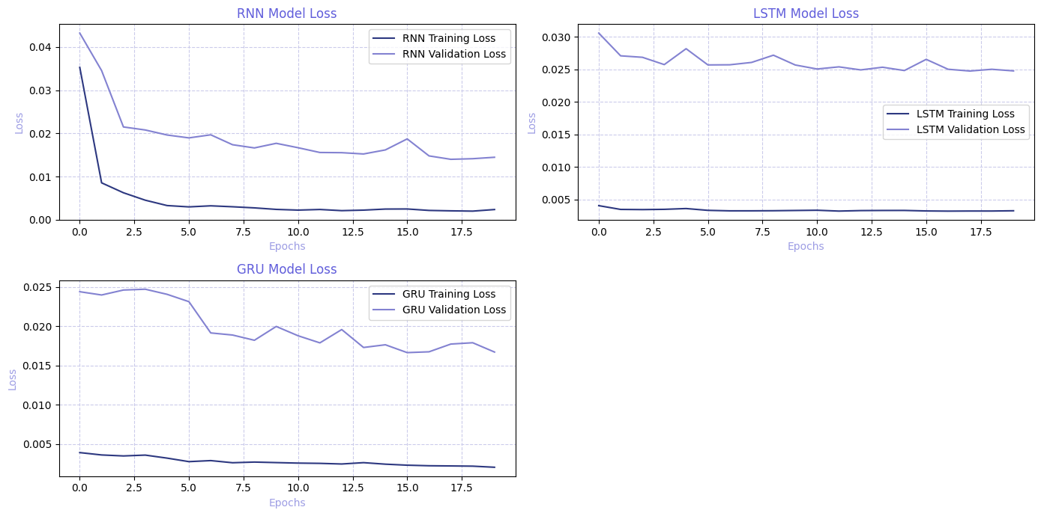
Model Evaluation (MSE)

Slide 10

Conclusion
In this project, we compared RNN, LSTM, and GRU models for traffic accident data prediction. The RNN model achieved the lowest Mean Squared Error (MSE), making it the most effective for this task. This result highlights the RNN’s potential for accurate real-time traffic forecasting.

Slide 11
Q and A
Do you have any specific questions about the project?

Slide 12

Group Members
1|
Feras Alsayigh
2|
Abdullah Aloufi
3|
Noura Aldawsari
4|
Shahad Alhmoud

Slide 13

Thank You

